Slide 1

Face recognition bot
Guided by
mr. Manu jose, assistant professor of ece
Presented by
Aminul ansha Noushad (VJC20EC009)
Fathima m.a (VJC20EC018)
Jifi jimmy (VJC20EC020)
k.B nandana (VJC20EC021)

Slide 2
INTRODUCTION
Face recognition bot – AI based product
Bot – robot without body
Computer Vision-based project
Identify & recognize human faces
To develop a machine - its own intelligence
Act as real servants
Identify faces without any physical touch or physical ID

Slide 3
Literature survey
Weiyang Liu1 Yandong Wen2 Zhiding Yu2 Ming Li3 29 Jan 2018SphereFace: Deep Hypersphere Embedding for Face Recognition Metric learning Deep face recognition Deep Hypersphere Embedding Soft max Los
Qiong Cao, Li Shen, Weidi Xie, Omkar M. Parkhi and Andrew Zisserman13 May 2018: Visual Geometry Group, Department of Engineering Science, University of Oxford face dataset; face recognition; convolutional neural networks

Slide 4
Process
Unique features – nose, eyes, iris, nose width, lips, cheeks and jaws
Photos are captured
Nodal points are considered
Each person has their own unique facial signature
Extracted & compared - databases

Slide 5
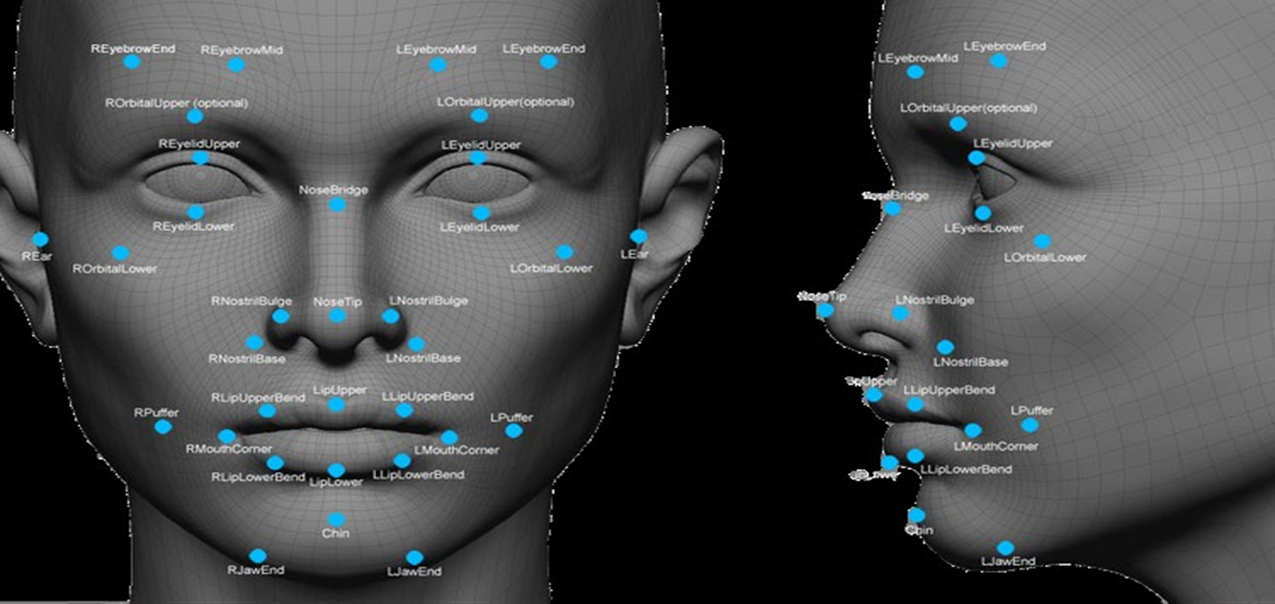

Slide 6

Flowchart
Start
Capture image
Preprocessing
Face detection
Face alignment

Slide 7

Feature extraction
Database query
Thresholding
Match found
Display result
End

Slide 8

Block diagram
face detection
Feature extraction and mapping
Image source
Training
Access granted
Yes
Recognize the face and generate face ID
Model for matching
Testing
Access denied
No
User’ll be notified with the photo

Slide 9
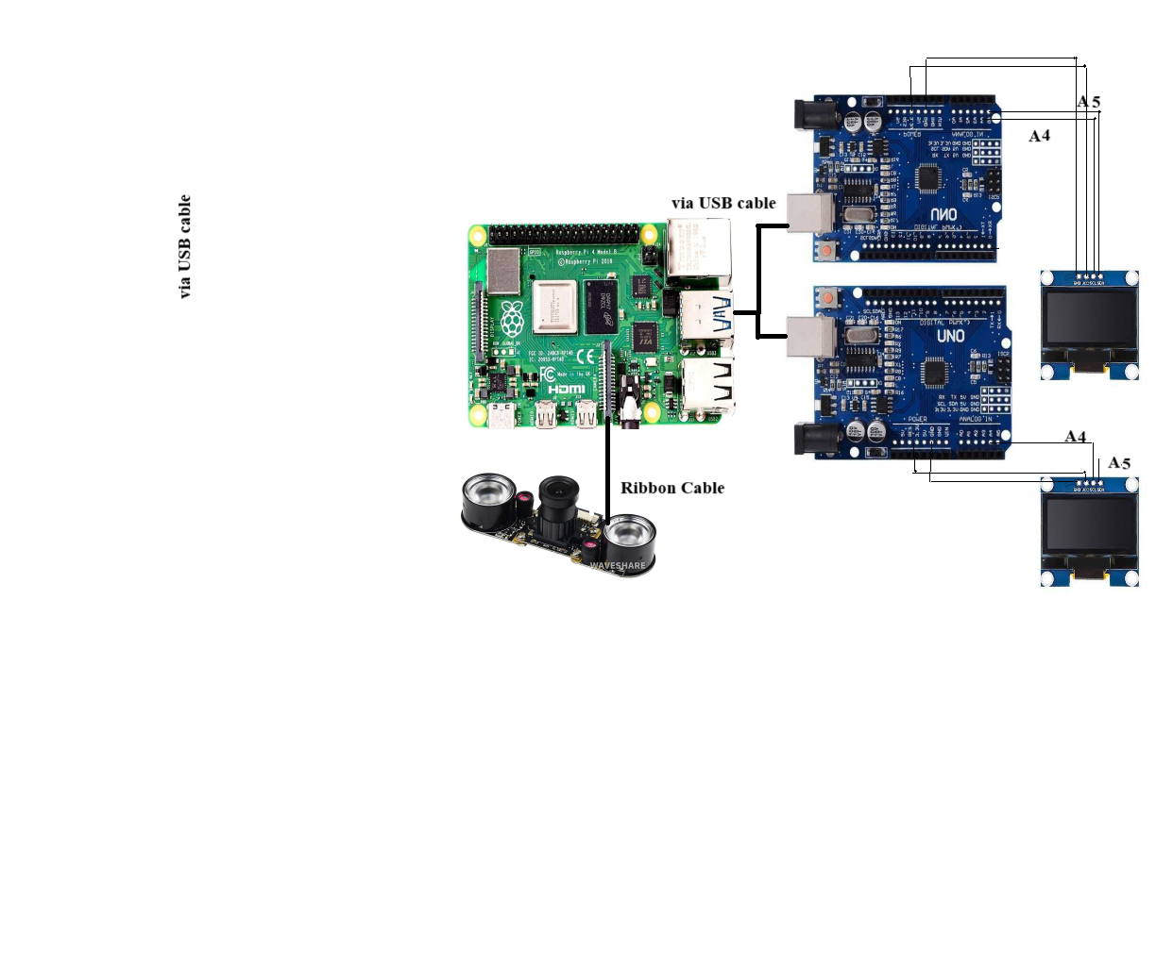
Implementation
RIBBON CABLE
9

Slide 10
Components
1. OLED SSD1306
2. Arduino UNO board
3. Raspberry pi board
4. Raspberry pi camera

Slide 11
6. A hard cardboard to mount the head
7. USB data cable
8. 5 V power adapter
9. Connecting wires

Slide 12
HARDWARE COMPONENTS

Slide 13
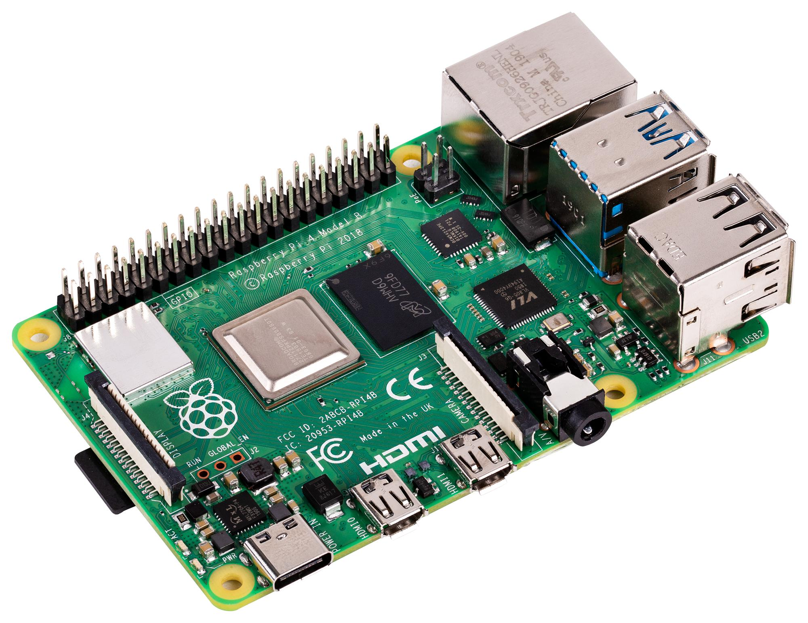
RASPBERRY PI 4
RAM 4G
Connectivity: 2.4 GHz and 5.0 GHz IEEE 802.11b/g/n/ac wireless LAN.
Bluetooth 5.0, BLE.
Storage: MicroSD card slot for operating system and data storage.
Power: 5V DC via USB-C connector (minimum 3A)
Dimensions: 85mm × 56mm × 17mm

Slide 14
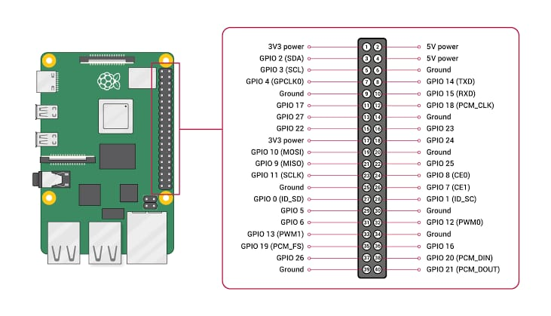
MicroSD card slot
USB C-power port
2 Micro HDMI
Ports
Camera port
4 pole stereo audio
USB
Gigabit
Ethernet

Slide 15
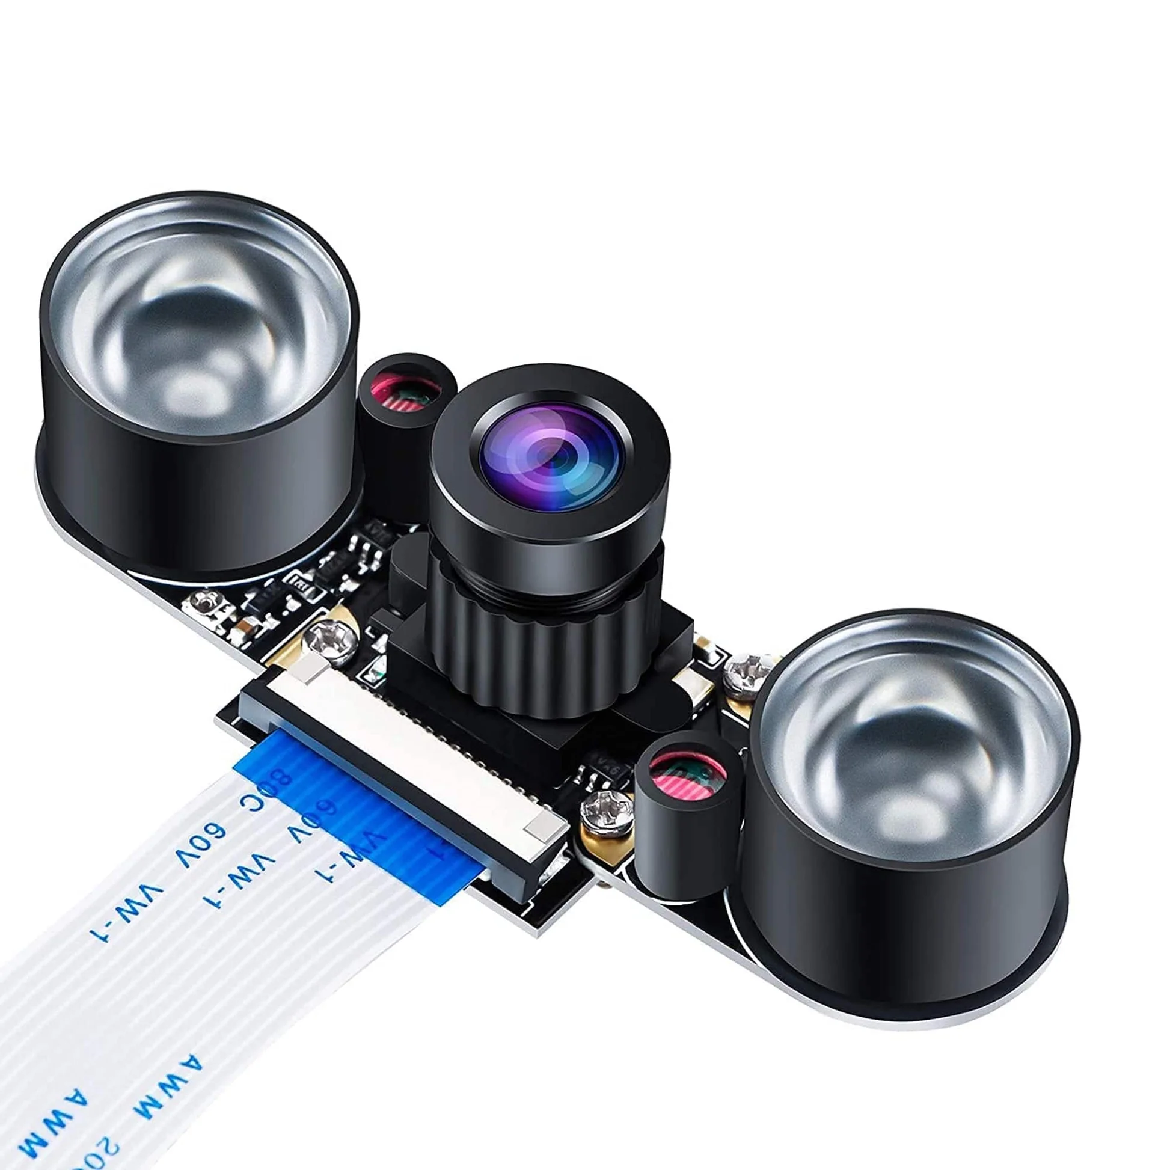
Raspberry pi camera
Webcam Video 1080p for Raspberry-Pi 4 Model B, Model B+
Night Vision
This camera can adjust focus.
HD video recording possible

Slide 16
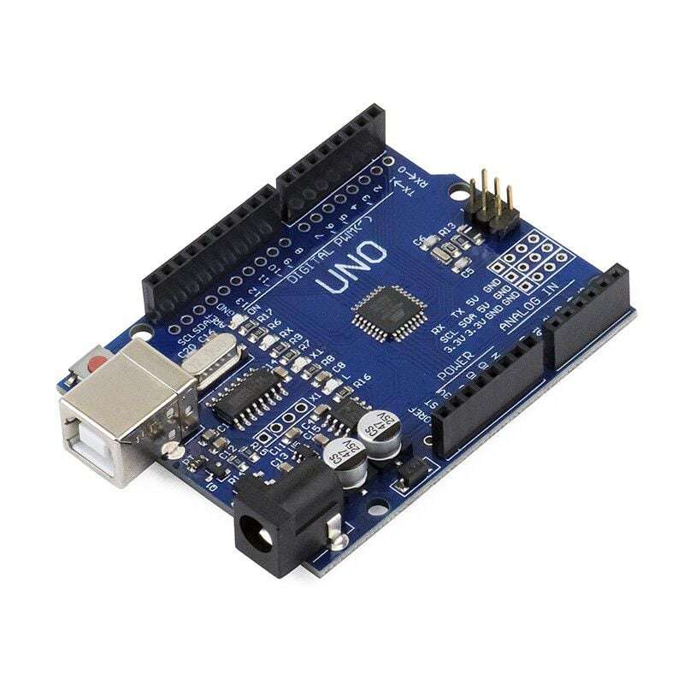
ARDUINO UNO
Operating Voltage: 5V
Input Voltage: 7-12V
Digital I/O Pins: 14
Analog Input Pins: 6
DC Current per I/O Pin: 20 mA
Flash Memory: 32 KB
Clock Speed: 16 MHz
USB interface: Serial communication

Slide 17
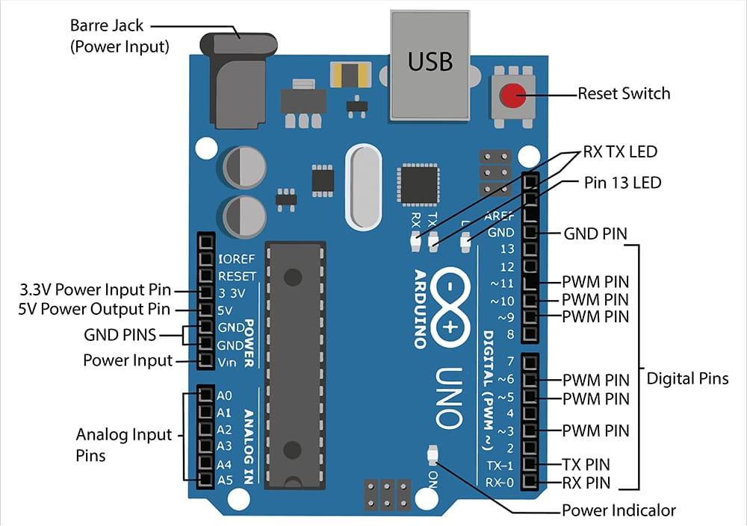

Slide 18
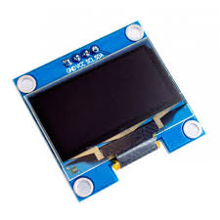
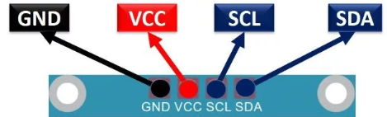
OLED SSD1306s
OLED (Organic Light Emitting Diode)
Monochrome display: white or blue pixels on a black background.
Interact through a microcontroller like Arduino, Raspberry Pi.
Operating Voltage: The voltage range required to power the OLED display typically such as 3.3V or 5V.

Slide 19
SOFTWARES USED

Slide 20

Software used
VNC VIEWER – Raspberry pi virtual display
to remotely access and control another computer over a network.

Slide 21
Software used
PYTHON
OPEN CV -
computer vision and image processing tasks.
Functionalities : object detection, facial recognition, image segmentation
DLIB – Machine learning ( training of data ) -
includes machine learning support vector machines, deep learning, and clustering.
Functionalities : computer vision applications like object detection, face recognition, and facial landmark
detection

Slide 22
Software used
FACE RECOGNITION
provides face detection, face alignment, and face recognition capabilities
to train custom face recognition models using labeled images of faces
VS CODE (VISUAL STUDIO CODE)
supports a wide range of programming languages and extensions
Features : syntax highlighting, intelligent code completion, debugging support

Slide 23
Hurdles to overcome
Occlusion
Lighting
Facial expression
Orientation
Accessories

Slide 24
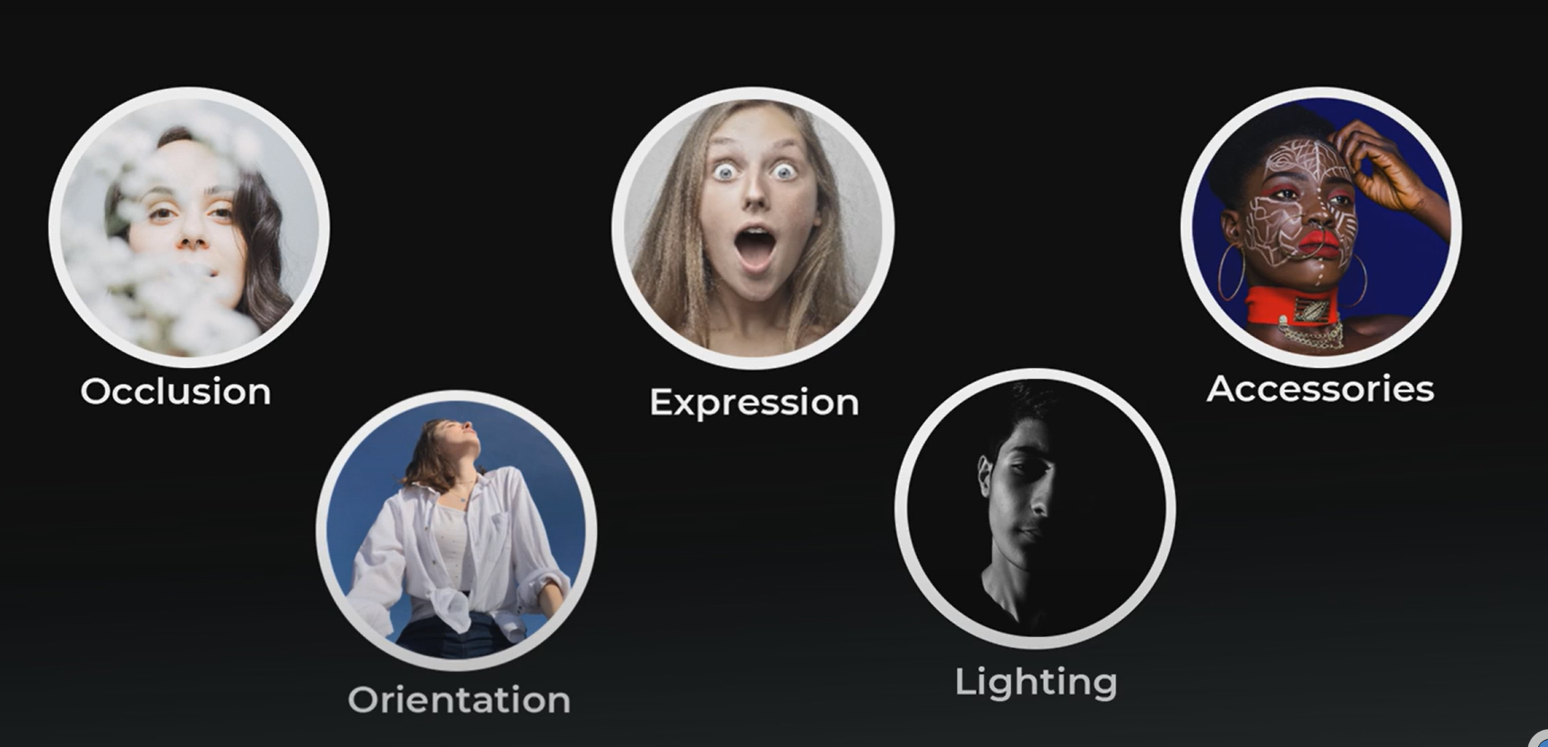
Occlusion
Expression
Accessories
Orientation
Lighting

Slide 25
Applications
Security purpose
Tracking attendance
Identification of individuals
Criminal identification
Police authority
Défense & bank ( unauthorised one to locker )

Slide 26
Components budget
Sl no. | Components ,specifications | Quantity | Amount
1 | Raspberry pi 4, 4GB | 1 | 4900
2 | Raspberry pi camera module | 1 | 1245
3 | Arduino UNO | 2 | 1200
4 | OLED SSD1306s | 2 | 460
5 | USB cable | 2 | 72
6 | Adapter | 1 | 220
7 | Mask etc | 1 | 60
TOTAL
8157 ( approx. 10K )

Slide 27
ADVANTAGES & DISDVANTAGES
ADVANTAGES
DISADVANTAGES
Better security
Easy integration
Automated identification
Huge storage requirements
Vulnerable detection
Potential privacy issues

Slide 28
Implementation, simulation & results

Slide 29
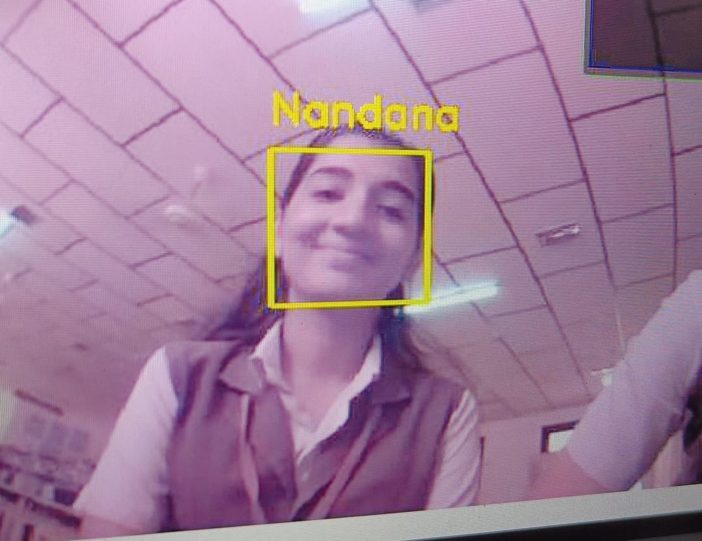
Detecting authorised user

Slide 30
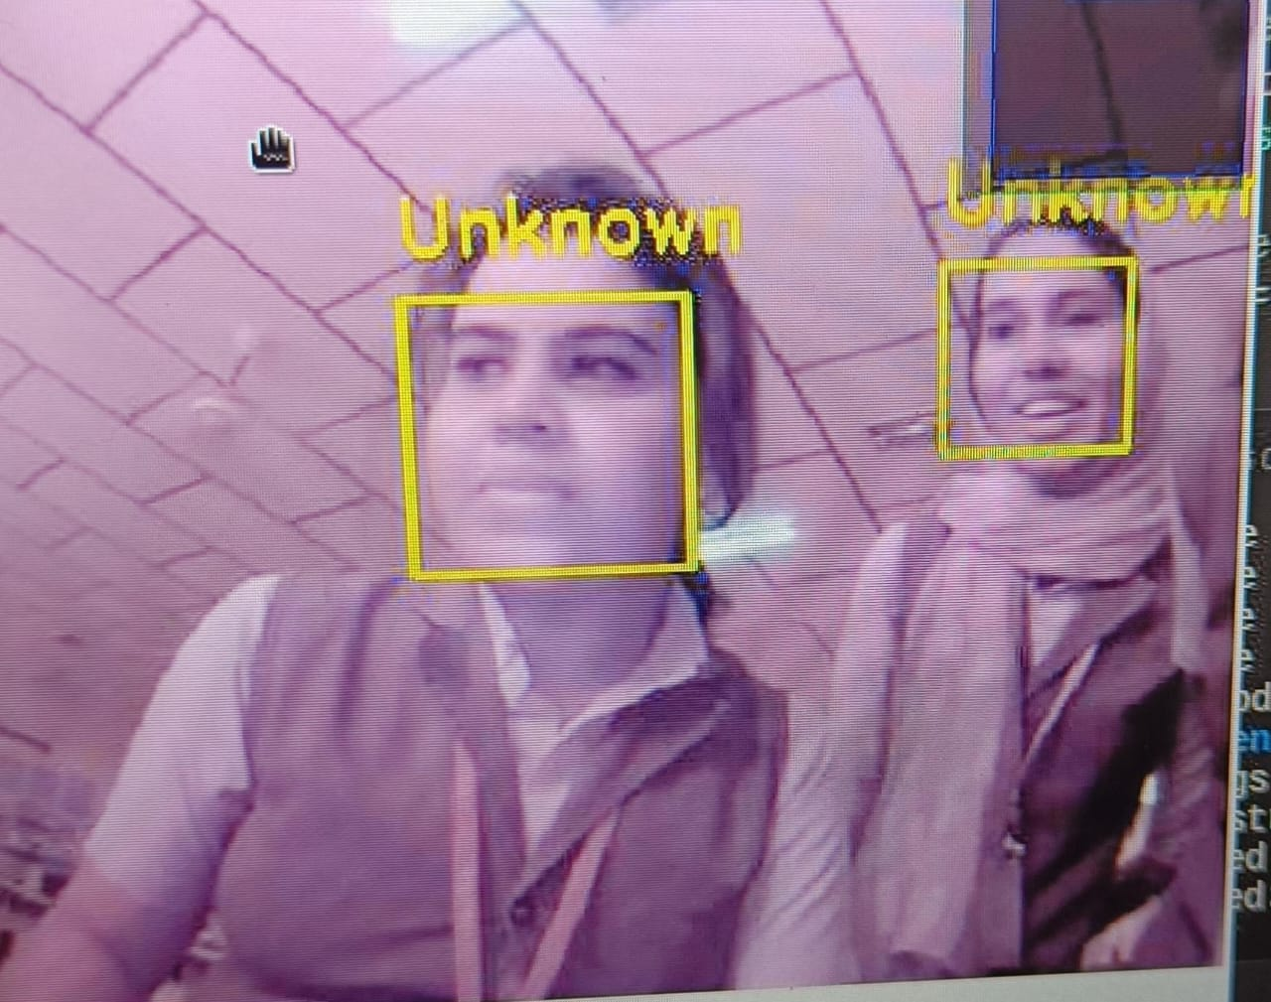
Detecting unauthorised user

Slide 31
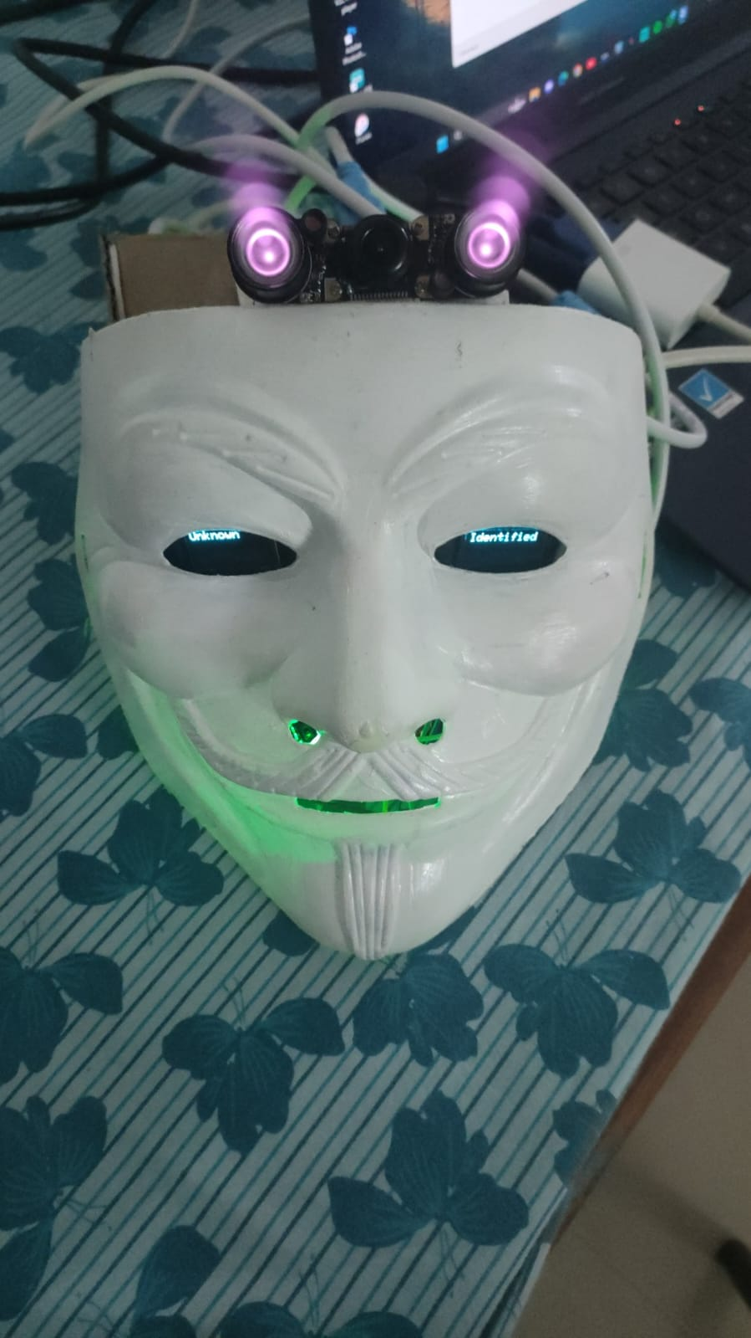
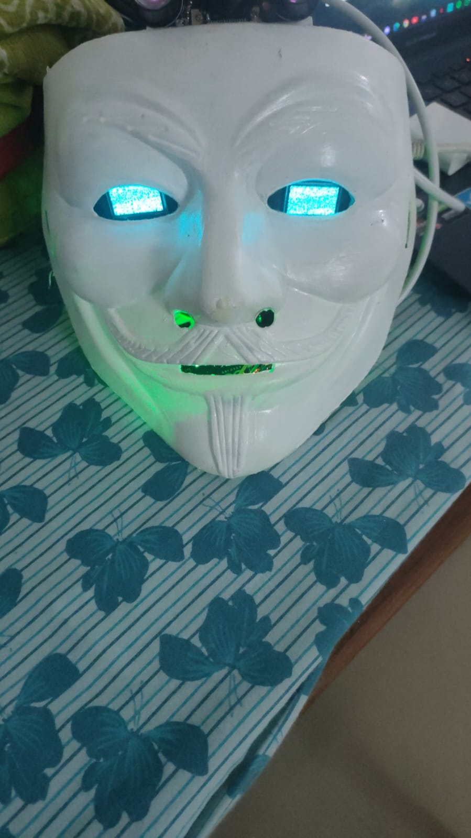
FINAL PRODUCT

Slide 32
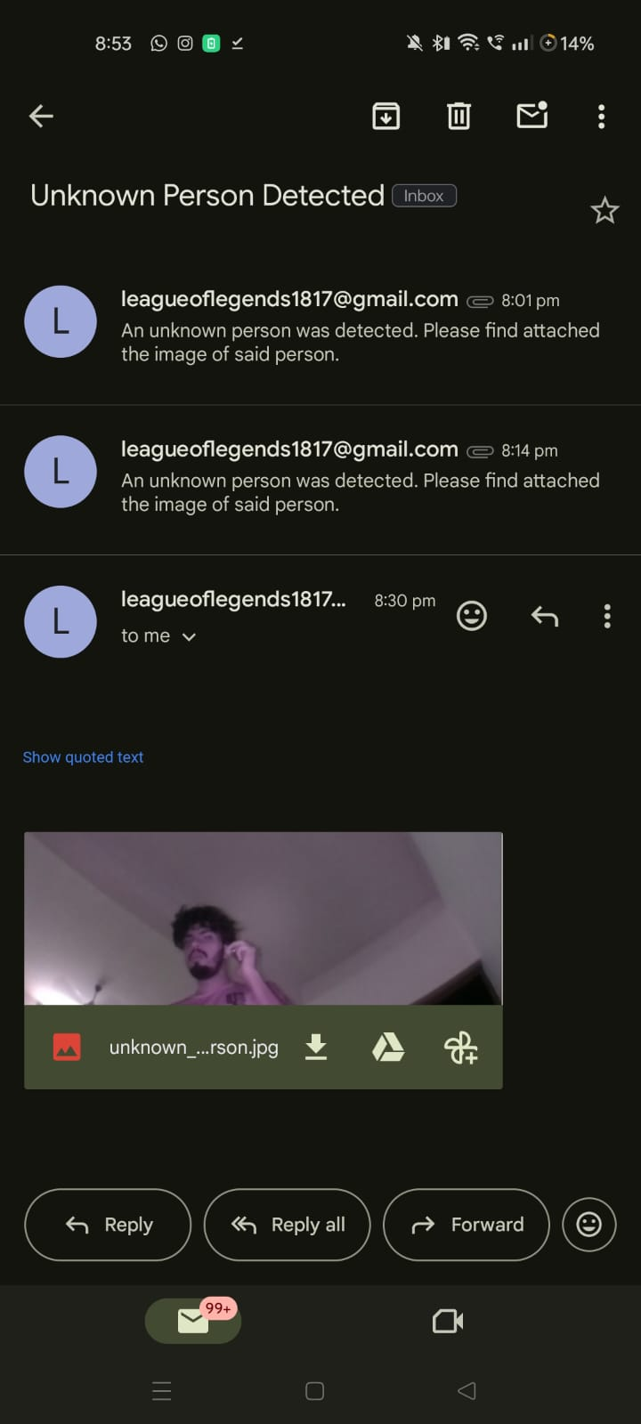

Slide 33
Conclusion
The development and implementation of a face recognition bot mark a significant stride in the field of artificial intelligence and computer vision.
The ability of such a system to accurately identify and authenticate individuals based on facial features brings about a myriad of potential applications, ranging from enhancing security protocols to streamlining user experiences in various industries.
The face recognition bot's success lies in its capacity to adapt and learn from diverse datasets, enabling it to handle a wide array of facial variations and expressions. However, ethical considerations regarding privacy and data security must be carefully addressed to ensure responsible and transparent deployment.
In essence, the face recognition bot represents a powerful tool with the ability to streamline and secure processes in both public and private domains.

Slide 34
reference
N. Bellustin, Y. Kalafati, Kovalchuck, A. Telnykh, O. Shemagina, V. Yakhno, Abhishek Vaish, Pinki Sharma, and Shirshu Verma. 2011. Instant Human Face Attributes Recognition System. IJACSA, Special Issue Artif. Intel.: 112–120.
J Parris, M Wilber, B Heflin, H Rara, A EI_Barkouky, A Farag, J Movellan, M Castrillon-Santana, J LorenzoNavarro, M. N. Teli, S Marcel. 2011. Face and eye detection on hard datasets. In Biometrics (IJCB), 2011 International Joint Conference on , pp. 1-10. IEEE.

Slide 35
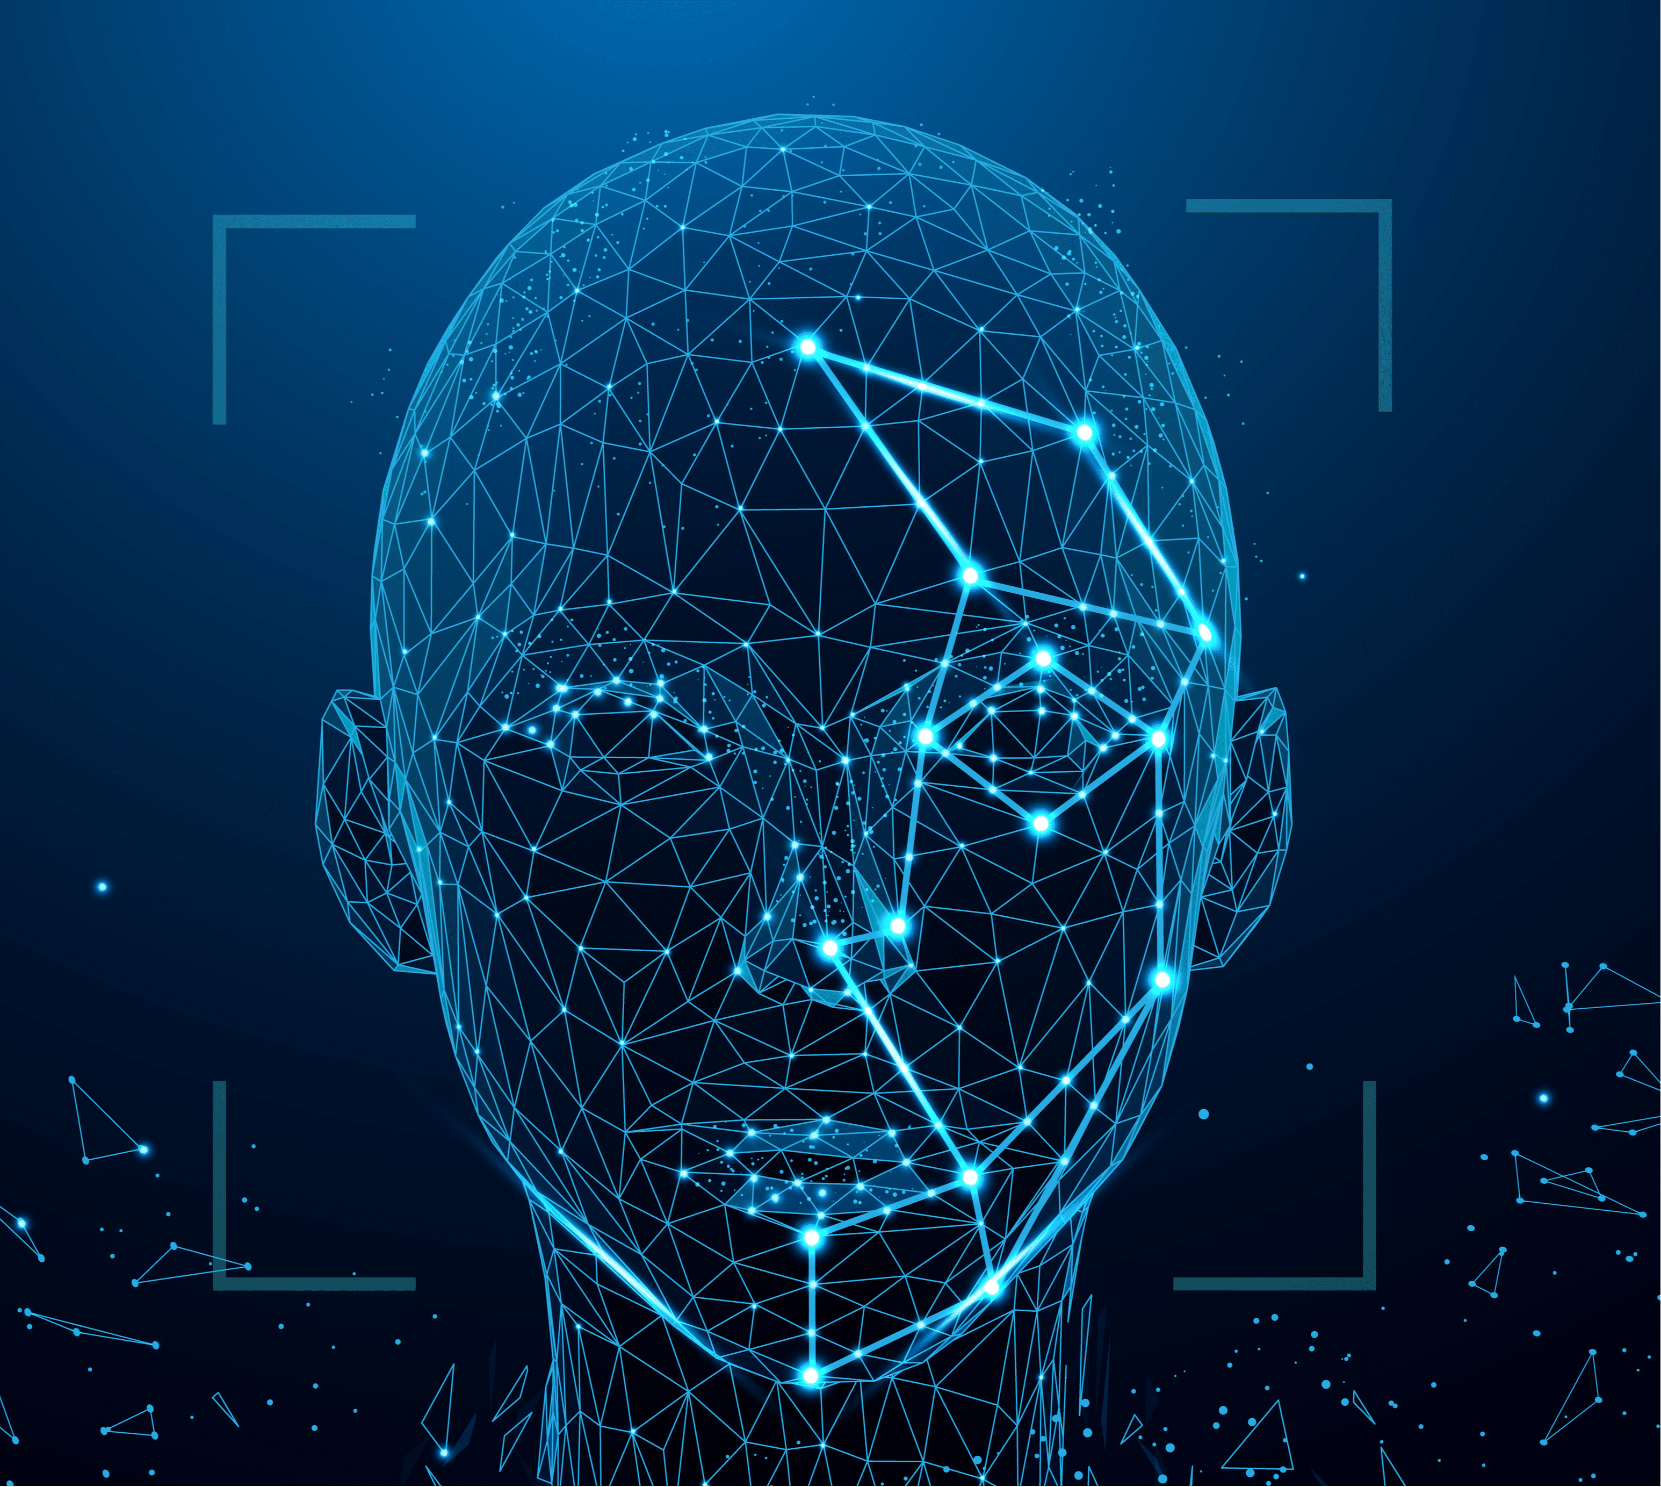
Thank you

